Slide 1
POTHOLE DETECTION FOR VISUALLY IMPAIRED USING YOLO
PROJECT GUIDE | : | Dr. P. ARJUN M.E, PhD HOD of CSE dept , UCEV
PROJECT MEMBERS | : | BALAJI V VIGNESH B

Slide 2
ABSTRACT
The visually impaired people facing many problem in day to day life. The path hole is the major problem in walking. So pothole detection plays a important role in visually impaired people.
We propose a solution that is in the form of Mobile phone app that detects pothole on the road surface especially Indian roads. The dataset used here was modified for Indian roads and visually impaired people.
The Object detection algorithm used here was YOLO (You Only Look Once) which achieves faster detection of 45 frames per second. A single neural network predicts bounding boxes and class probabilities directly from full images in one evaluation.
Conventions : YOLO - You Only Look Once, VI – Visually Impaired.

Slide 3
INTRODUCTION
Humans can find the objects in the image at a glance, where they are and how they interact. Human visual system is fast, accurate and perform very complex task. Fast and accurate algorithms make computers to see the world like human.
Current technologies have the capabilities to attend performance near to human. Although we are in development stage. But the problem with this systems they need heavy computational resources. An efficient algorithm might solve this problem.
YOLO is one of the such algorithm that might solve this problem. The system proposed here might solve the problem of VI people. According to WHO nearly 285 million people are VI worldwide: 39 million are blind and 246 million have low vision (severe or moderate visual impairment).

Slide 4
Blindness is the condition of lacking discernment because of physiological or neurological components. They have difficulties in walking and navigation. Although many new technologies were developed but it remains a significant issue till now.
Pothole in the roads is the main obstacle for the VI people to navigate them independently. The system proposed here might solve the problem of path hole specially for VI. The algorithm used here is YOLO (You Only Look Once).
YOLO, a new approach to object detection. YOLO is extremely fast in object detection. YOLO is refreshingly simple. A single convolutional network simultaneously predicts multiple bounding boxes and class probabilities for those boxes.
YOLO trains on full images and directly optimizes detection performance. We develop a solution in remote manner. i.e. Creating an android app that detects pothole in roads and gives assistive audio output specially for VI people using YOLO algorithm.

Slide 5
LITRATURE SURVEY
TITLE | AUTHOR | YEAR / PUB | DATASET USED | MERITS | DEMERITS
You Only Look Once: Unified, Real-Time Object Detection | Joseph Redmon, Santosh Divvala, Ross Girshick, Ali Farhadi | 2016 / IEEE |  | It tells about base YOLO algorithm. | It doesn’t tells about object detection for VI people.
Path Hole Detection to Assist the Visually Impaired People in Navigation | Md. Milon Islam, Muhammad Sheikh Sadi | 2018 / IEEE | Kitti road, Pothole detection | It tells about pothole detection for VI people. | It doesn’t uses YOLO algorithm.
Pothole Detection System Using YOLO V4 Algorithm | Kshitija Chavan, Chinmay Chawathe, Vatsal Dhabalia, Amruta Sankhe | 2022 / IRJET |  | It tells about pothole detection using YOLO. | It doesn’t tells anything about VI people

Slide 6
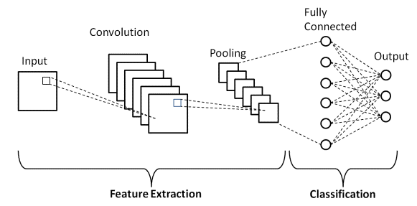
EXISTING SYSTEM
A CNN entails of some layers. The layers of CNN are Convolution layer, Pooling layer, Activation function and Fully connected layer. This network have developed consists of two convolutional layers and two subsampling layers each following only one convolutional layer.

Slide 7
TECHNIQUES USED IN THE EXISTING SYSTEM
The existing system uses CNN for detection and KITTI ROAD and pothole detection as dataset. A kitti road set consists of 289 road surface images with no pothole. Pothole detection set consists of 90 road surface images with pothole.
The training set consists of 260 images and the testing set consists of 119 images. For image recognition and classification, CNN (Convolutional Neural Networks) is used.
For both convolutional layers, the kernel size remains fixed and is 3x3 where in both subsampling layers, the size of the pooling area is 2×2. Following this is a dense layer, containing a linear representation of the terminal subsampled feature map’s units those are connected to the 2 neurons in the output layer for classifying images into 2 classes.

Slide 8
Path hole are determined from a particular neuron in the output layer and non-path hole are determined from another neuron. When the path hole neuron value outputs 1, the other neuron value goes 0 and vice versa.
The kernels, as well as the hidden-output weights, are updated while training process continues for a 20 and 30 number of epochs. The input images are in size of 32x32. We have used max pooling operation with the size 2x2 and ReLU as an activation function.

Slide 9
PROBLEM STATEMENT
The existing works uses CNN, R-CNN and many algorithms for object detection, But these algorithms require heavy computational resources. This approach should not be used in real-time and in remote manner for VI people.
To solve these problems, we propose a system that uses YOLO algorithm which lightweight and faster in object detection. It doesn’t require heavy computational resources. The input dataset is modified for VI people.

Slide 10
PROPOSED WORK
MODULES
The work we propose contains several modules such as Dataset collection, Pre-processing, Feature extraction, and Object Detection.
DATASET COLLECTION – Collection of Images with Pothole and without Pothole specific for VI people.
PRE-PROCESSING – Pre-processing of Images before detection.
FEATURE EXTRACTION – Extracting features using different network layers.
OBJECT DETECTION – Performing realtime detection.

Slide 11
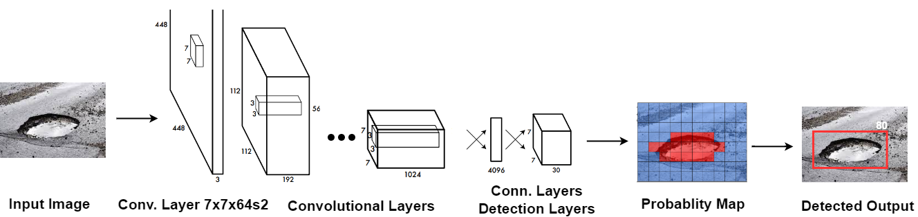
ALGORITHM OF PROPOSED WORK

Slide 12
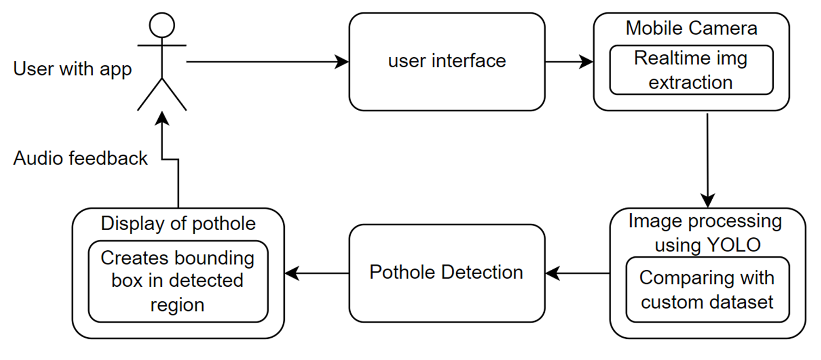
WORKING OF THE SYSTEM

Slide 13
The VI person is provided with android app on the mobile phone. The app in the mobile phone access the camera and get live video feedback. The system starts scanning for pothole from the video using YOLO algorithm.
If it encounters any pothole, It gives audio output like “Whoa !!! be careful there is a pothole in front”. The System is connected with Google Text to speech Engine. YOLO algorithm find the pothole and sends it to a python script with damage score.
Based on the severity of pothole, the python script generate a text message. That message is read loudly by GTTS System.

Slide 14
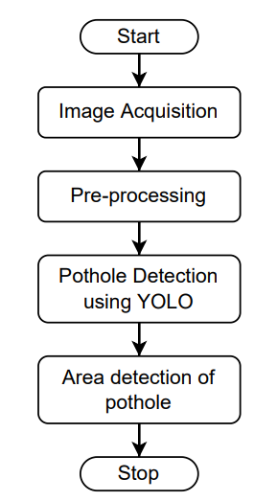
SYSTEM FLOW

Slide 15
SYSTEM FLOW
The real time video is analysed frame by frame for pothole detection. The larger the frame rate with more accuracy we can achieve more performance. The images are analysed and bounding box is created.
PREDICTING BOUNDING BOX
Centre of a bounding box (bx ,by)
Width (bw)
Height (bh) Y = (pc,bh,bw,bx,by,c)
Class of an object ( c )
Probability of object (pc)

Slide 16
REFERENCES
Joseph Redmon, Santosh Divvala and Ross Girshick, You Only Look Once. Unified, Real-Time Object Detection in 2016 IEEE Conference on Computer Vision and Pattern Recognition. CVPR 2016.91. pg 779-788 IEEE 2016.
Md. Milon Islam and Muhammad Sheikh Sadi, Path Hole Detection to Assist the Visually Impaired People in Navigation in 2018 4th International Conference on Electrical Engineering and Information & Communication Technology (iCEEiCT) 10.1109/CEEICT.2018.8628134 pg 268-273 IEEE 2018.
Kshitija Chavan, Chinmay Chawathe, Vatsal Dhabalia and Amruta Sankhe, Pothole Detection System Using Yolo V4 Algorithm in International Research Journal of Engineering and Technology (IRJET) Volume: 09 Issue: 04 | Apr 2022 pg 2777-2782 IRJET 2022.

